Slide 1
School of Geography and Earth Sciences McMaster University
Advanced Topics in Spatial Statistics
Area Data
V & VI

Slide 2
This session
Modeling area data
  Non-spatial regression models
Assumptions
  Non-constant variance
    Data transformations
  Error autocorrelation
    Moran’s I
  Normality

Slide 3
Example
Voter turnout
  What explains voter turnout in elections?
What do we know about the data?
  Variables follow a spatial pattern (Spatial autocorrelation)
  Variables are probably correlated

Slide 4
Example
Voter turnout: Variables
  VOTE
  Voting age population (POP)
  Population with grade 12 or higher education (EDU)
  Number of owner occupied houses (HOUSE)
  Aggregate income (INCOME)
Unit of analysis: county

Slide 5
Example
Do we have prior expectations about the direction of the relationships?

Slide 6
Example
Bivariate analysis
  Scatterplots
  Correlation coefficients

Slide 7
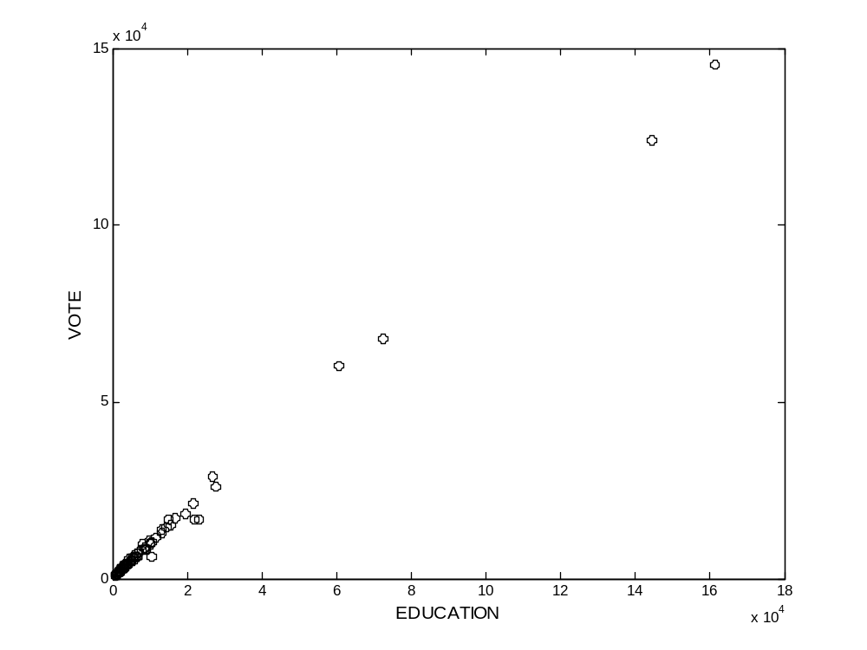
Example
Scatterplot (EDU vs. VOTE)

Slide 8
Example
Bivariate analysis
  Correlation coefficients
 | VOTE | POP | EDU | HOUSE | INCOME
VOTE | 1.00
POP | 0.993 | 1.00
EDU | 0.998 | 0.990 | 1.00
HOUSE | 0.997 | 0.994 | 0.994 | 1.00
INCOME | 0.994 | 0.983 | 0.998 | 0.989 | 1.00

Slide 9
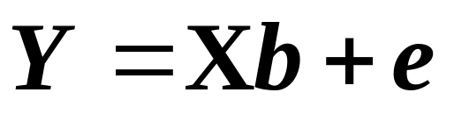
Example
Modeling area data
  Non-spatial regression
    Variables can be spatial
    Variables may be autocorrelated
    Assumes that there is no spatial autocorrelation
  Multiple regression

Slide 10
Modeling Area Data
Try different models
Model evaluation guidelines

Slide 11
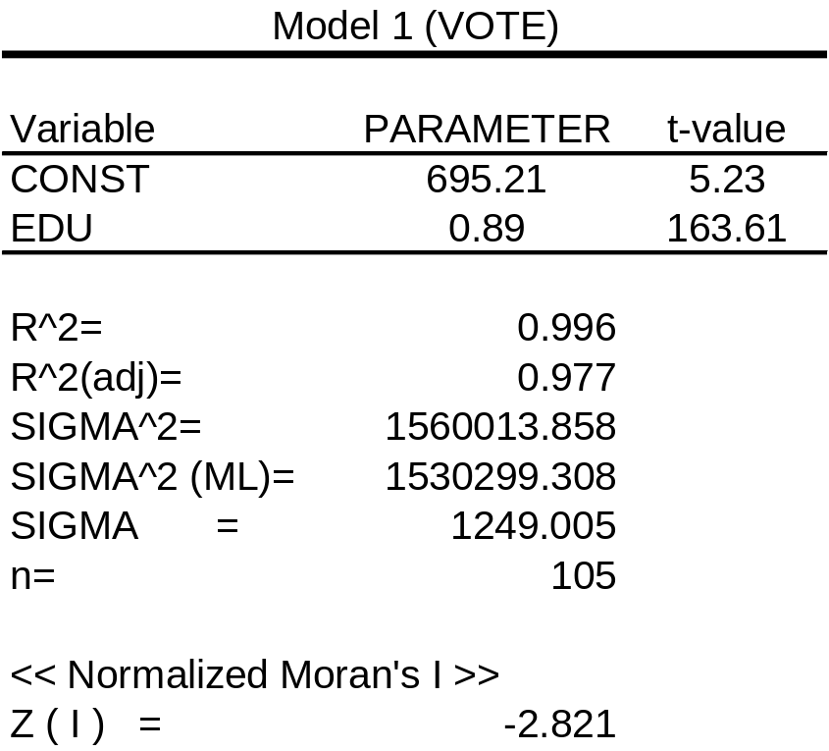
Modeling Area Data
Model 1

Slide 12
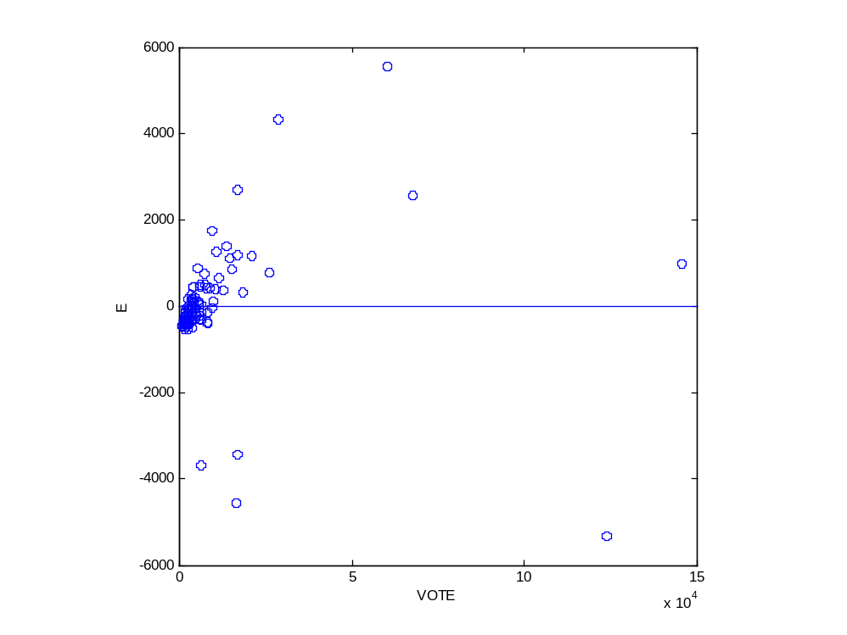
Analysis of Residuals
Is variance constant?
  Scatterplot of errors vs. variables

Slide 13
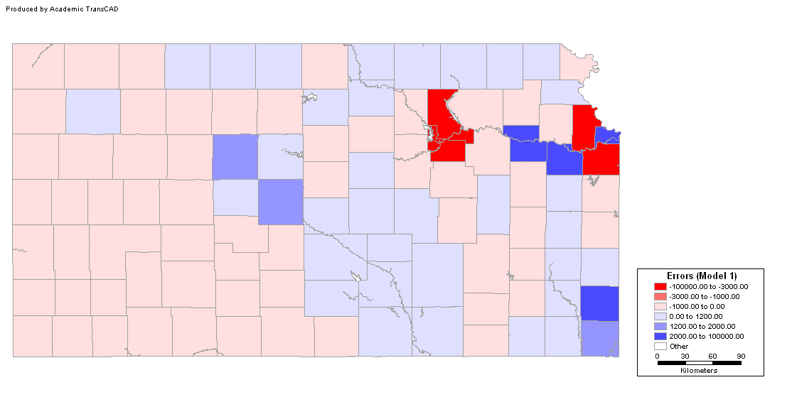
Analysis of Residuals
Are errors independent?
  Map of residuals

Slide 14
Analysis of Residuals
Are errors independent?
  Moran’s I
  Expected (mean) value of e is zero

Slide 15
Analysis of Residuals
Are errors normally distributed?
  Histogram
  Probability plot
  Other tests (Jarque-Bera, Kolmogorov-Smirnov,Lilliefors)

Slide 16
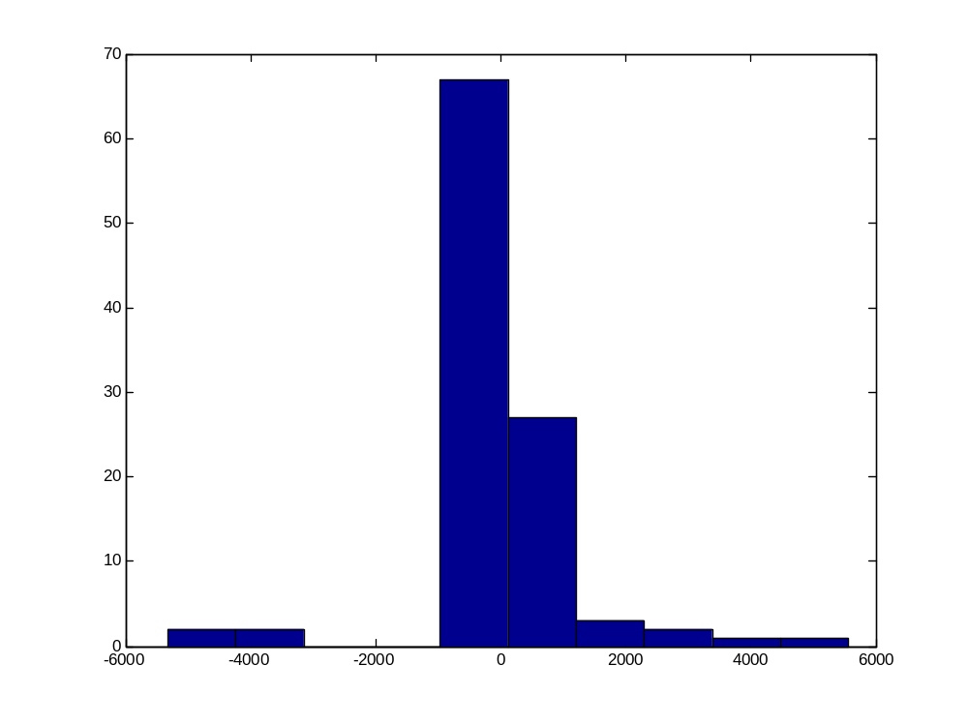
Analysis of Residuals
Histogram

Slide 17
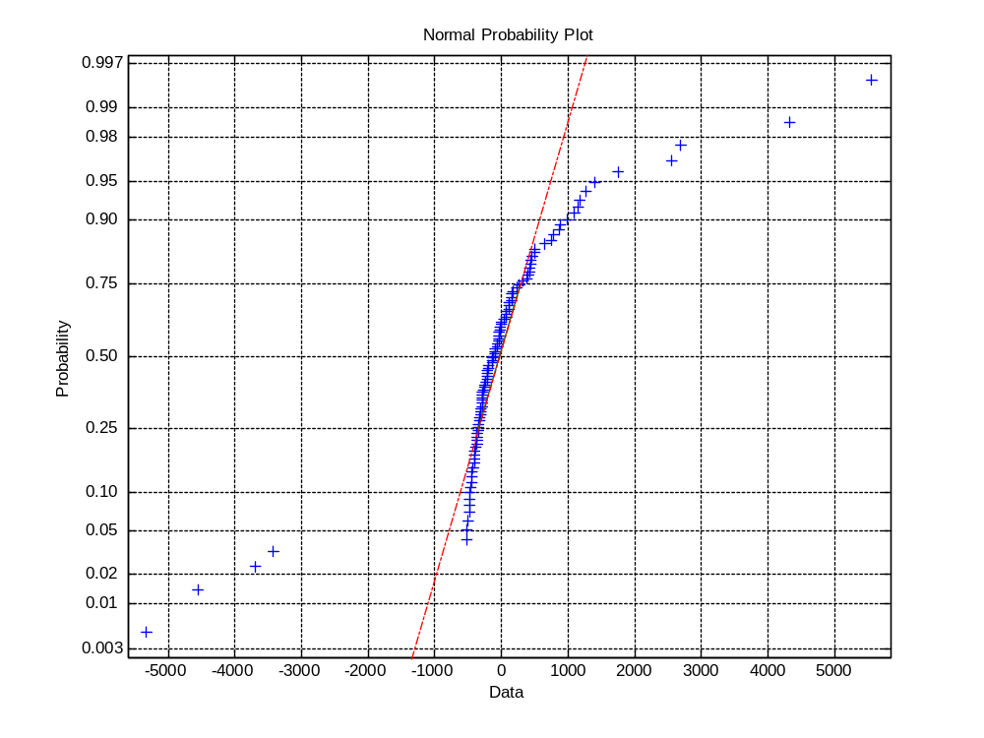
Analysis of Residuals
Probability plot

Slide 18
Modeling Area Data
What is the conclusion regarding this model?

Slide 19
Modeling Area Data
Data transformations
  May help to reduce size effects
  May increase the interpretability of the models

Slide 20
Modeling Area Data
Data transformations
  Instead of modeling totals, model the proportions
  Proportional voter turnout: VOTE/POP

Slide 21
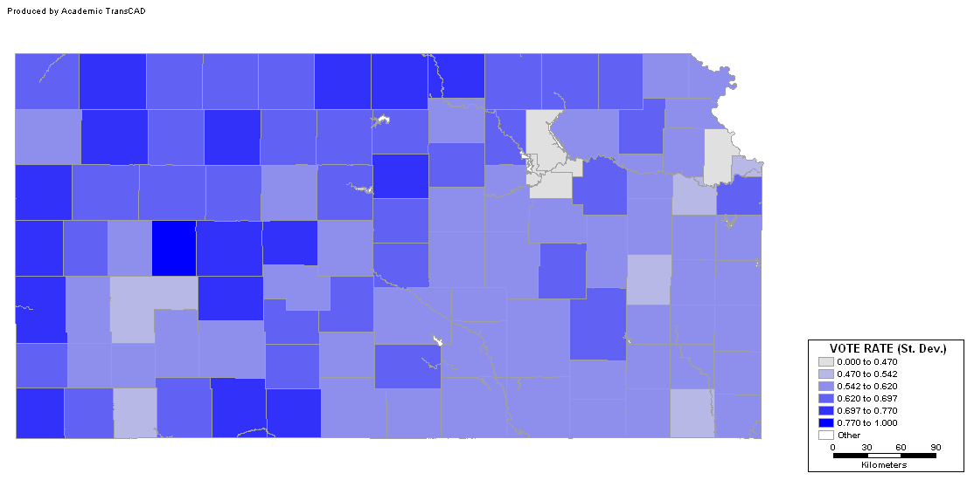
Exploring the Proportions
Choropleth map: PrVotes (Std. Dev.)
Notes:
What is the advantage of using standard deviations?

Slide 22
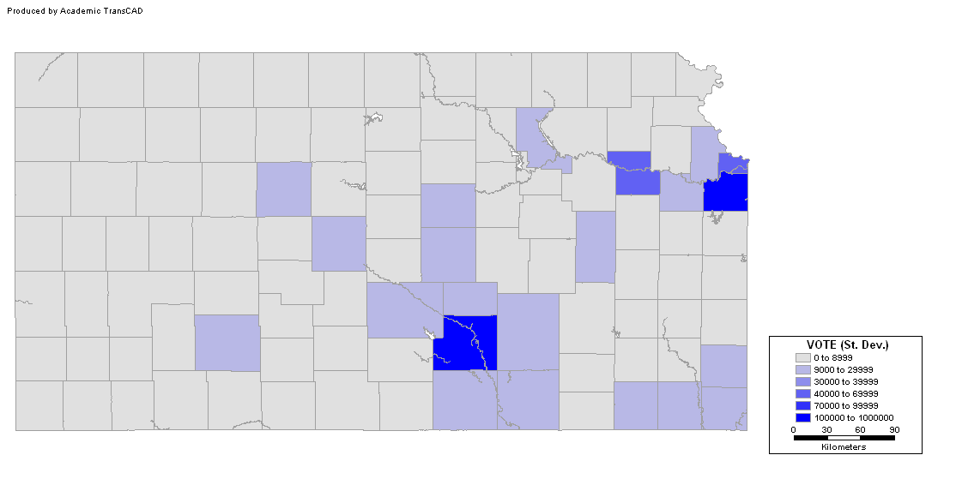
Exploring the Proportions
Choropleth map: Votes (Std. Dev.)
Notes:
What is the advantage of using standard deviations?

Slide 23
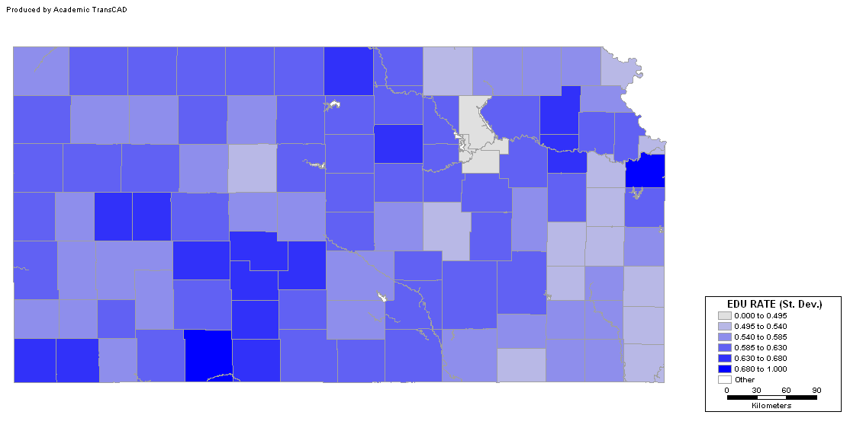
Exploring the Proportions
PrEDU (Std. Dev.)
Notes:
What is the advantage of using standard deviations?

Slide 24
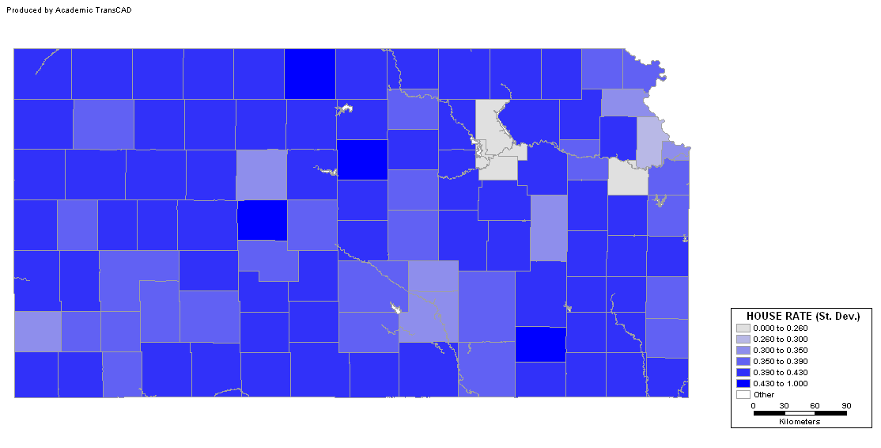
Exploring the Proportions
PrHOUSE (Std. Dev.)
Notes:
What is the advantage of using standard deviations?

Slide 25
Exploring the Proportions
PrINCOME (Std. Dev.)
Notes:
What is the advantage of using standard deviations?

Slide 26
Example
Bivariate analysis
  Scatterplots
  Correlation coefficients

Slide 27
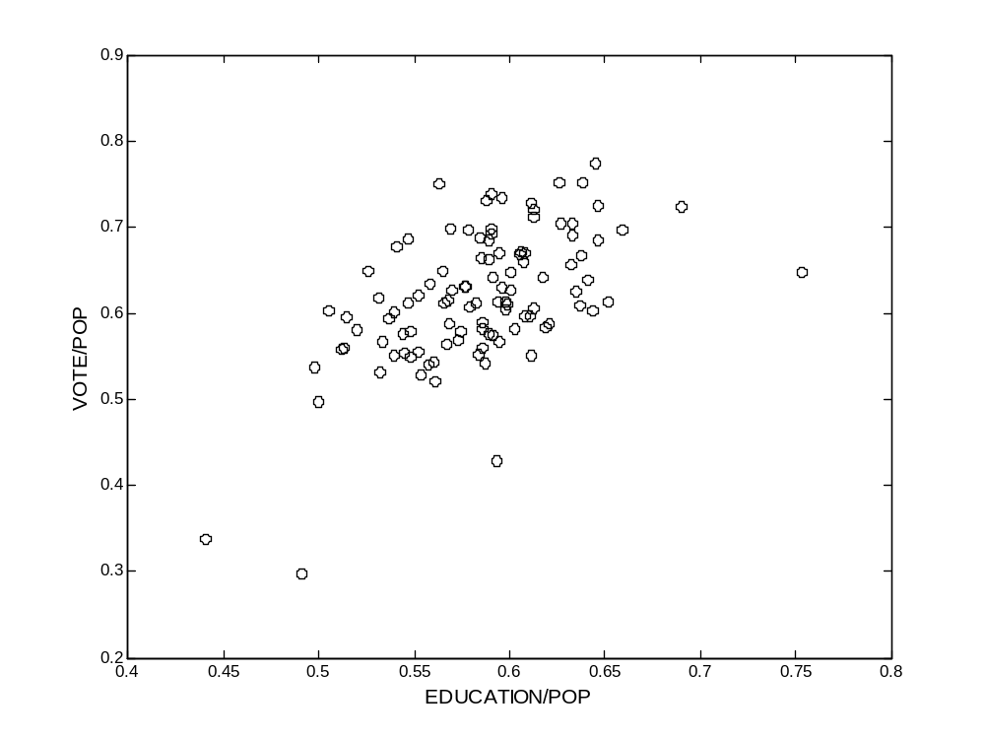
Example
Scatterplot (EDU/POP vs. VOTE/POP)

Slide 28
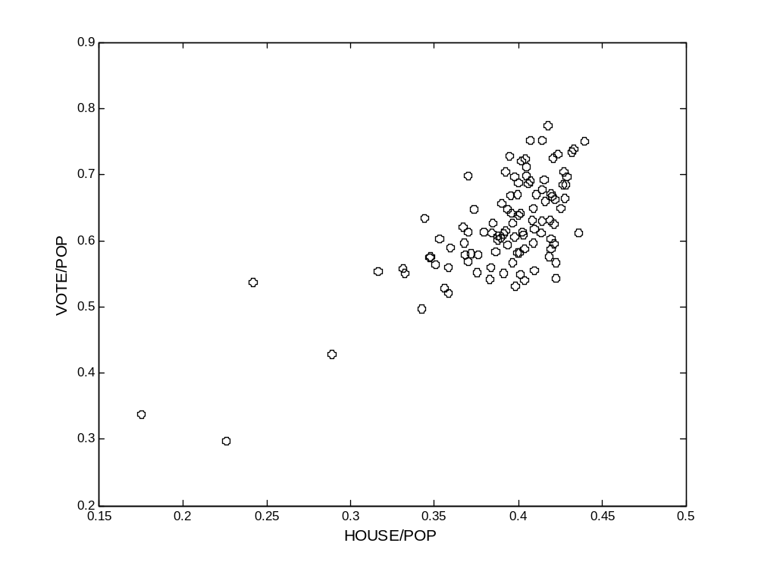
Example
Scatterplot (HOUSE/POP vs. VOTE/POP)

Slide 29
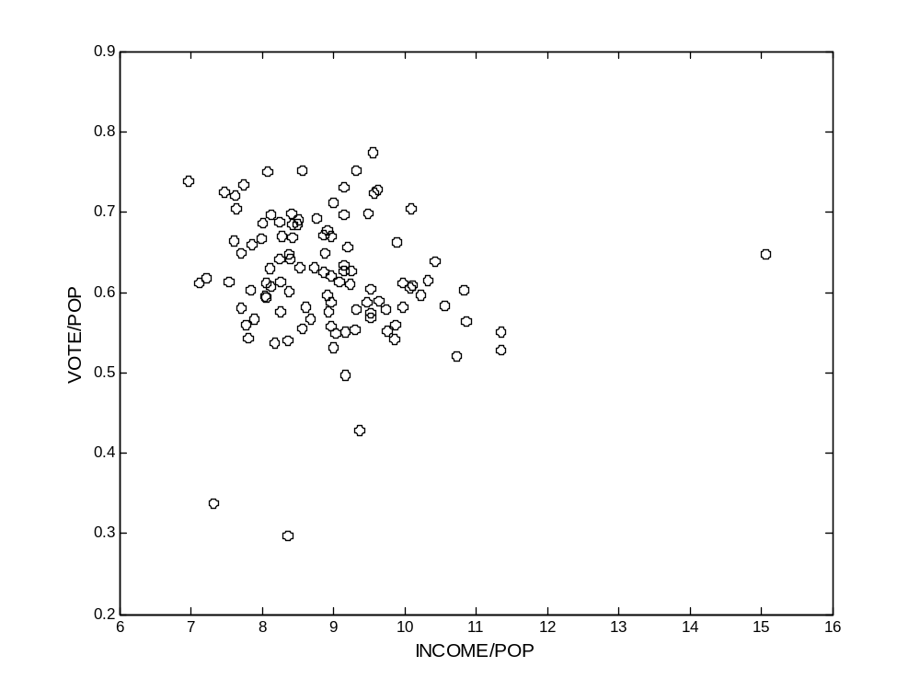
Example
Scatterplot (INCOME/POP vs. VOTE/POP)

Slide 30
Example
Bivariate analysis
  Correlation coefficients
 | VOTE/POP | EDU/POP | HOUSE/POP | INCOME/POP
VOTE/POP | 1.00
EDU/ POP | 0.563 | 1.00
HOUSE/POP | 0.718 | 0.392 | 1.00
INCOME/POP | -0.111 | 0.426 | -0.191 | 1.00

Slide 31
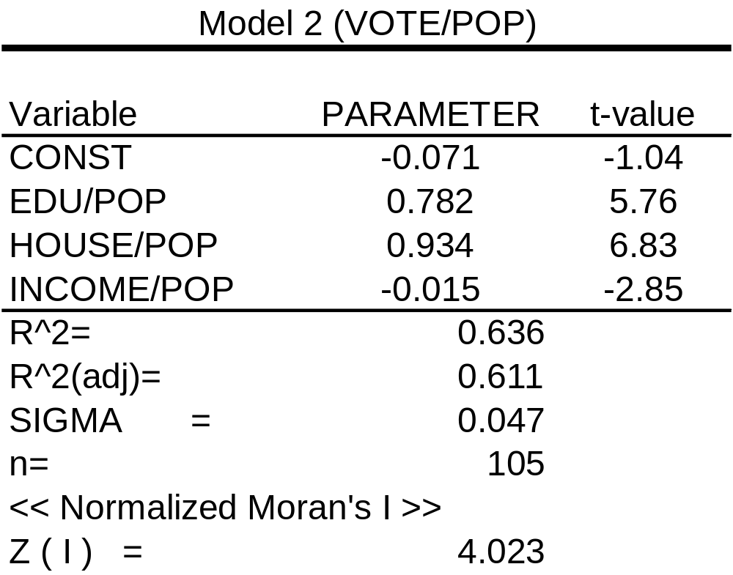
Example
Model 2

Slide 32
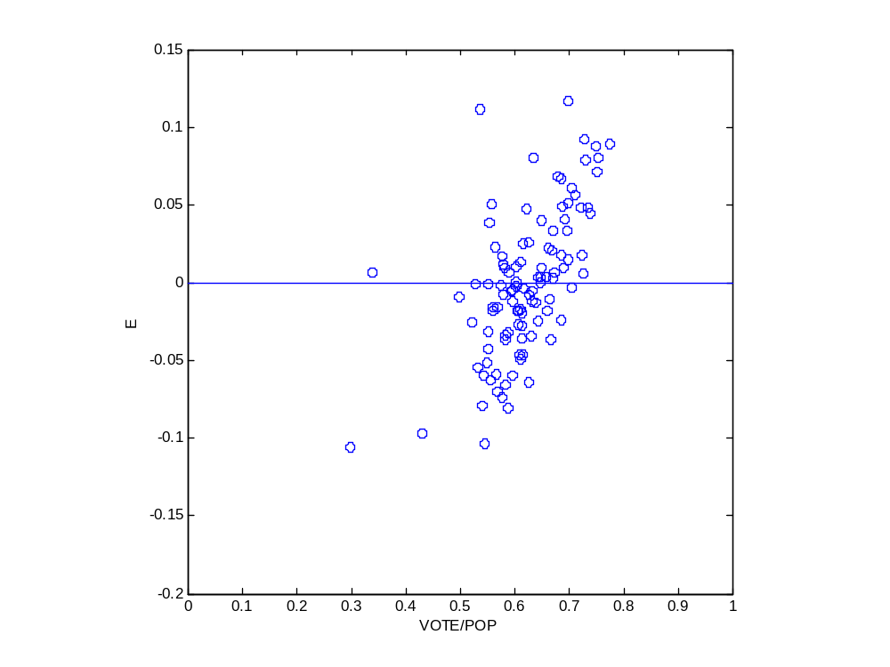
Analysis of Residuals
Is variance constant?
  Scatterplot of errors vs. variables

Slide 33
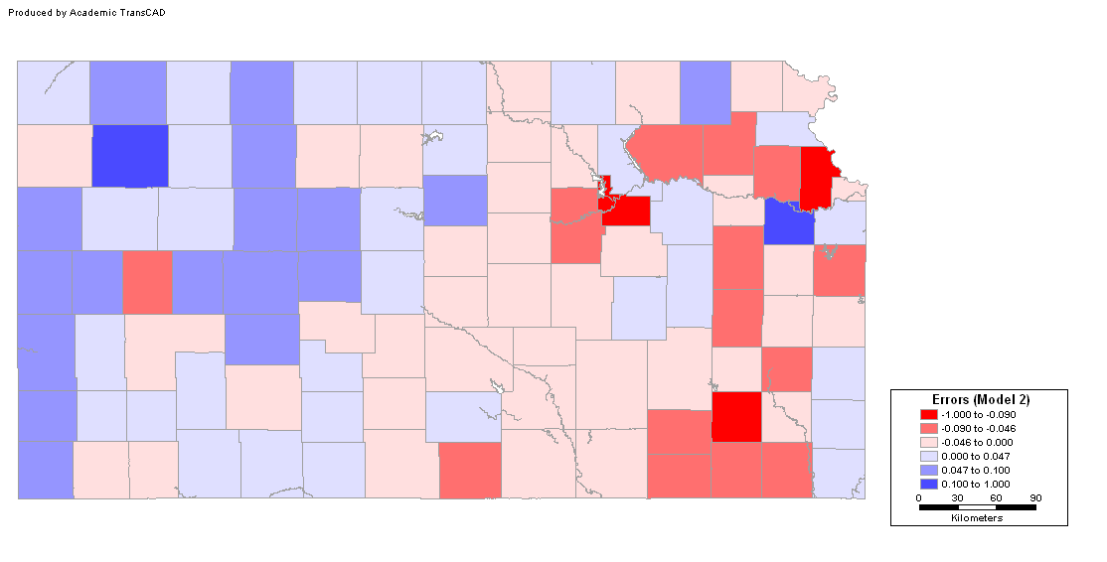
Analysis of Residuals
Are errors independent?
  Map of residuals

Slide 34
Analysis of Residuals
Are errors independent?
  Moran’s I
  Expected (mean) value of e is zero

Slide 35
Analysis of Residuals
Are errors normally distributed?
  Histogram
  Probability plot
  Other tests (Jarque-Bera, Kolmogorov-Smirnov,Lilliefors)

Slide 36
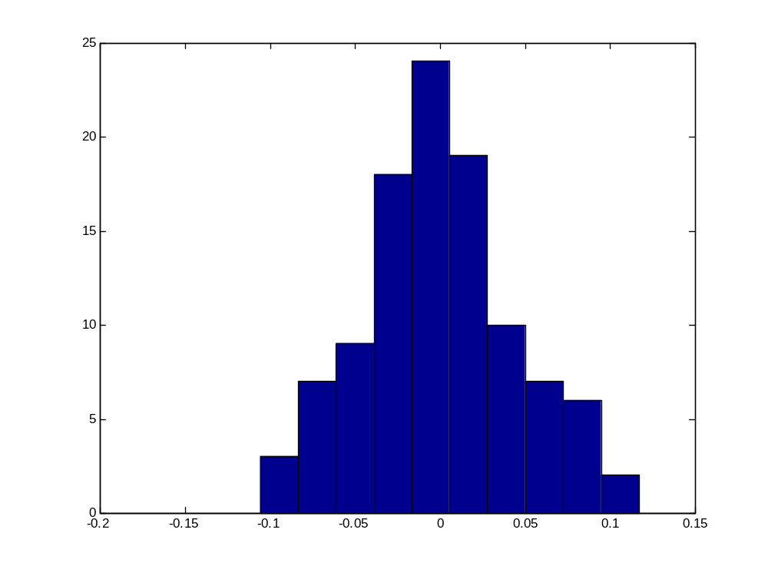
Analysis of Residuals
Histogram

Slide 37
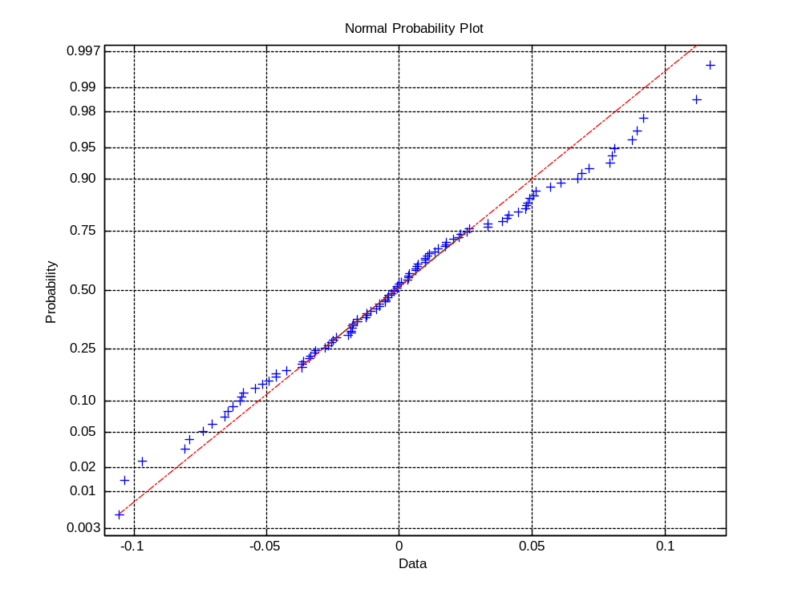
Analysis of Residuals
Probability plot

Slide 38
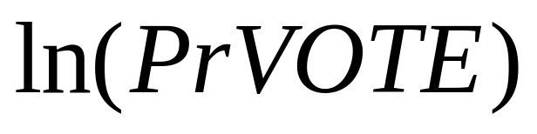
Modeling Area Data
Data transformations
  Logarithm of proportional voter turnout:
  Correlation coefficients
  Model
  Analysis of residuals

Slide 39
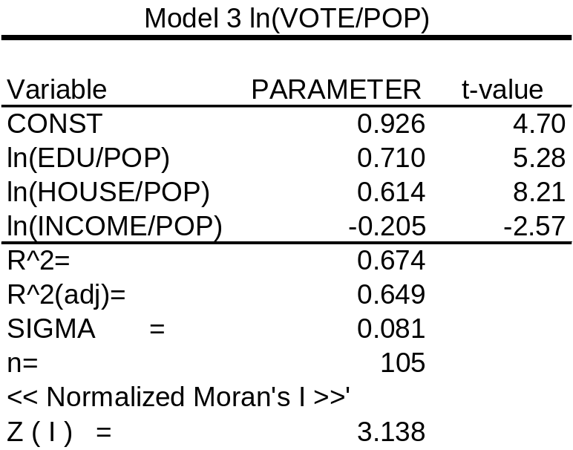
Variable Transformations
Taking logarithms:
Normality? No
Constant variance? Yes

Slide 40
Conclusion
Model selection
  Totals
  Proportions
  Logarithm of Proportions

Slide 41
Conclusion
All three models still show residual error pattern (error autocorrelation)

Slide 42
Non-spatial Regression
Data transformations may help to reduce problems with the residuals + increase interpretability
In the example: All three models show residual error pattern (error autocorrelation)
Spatial regression models

Slide 43
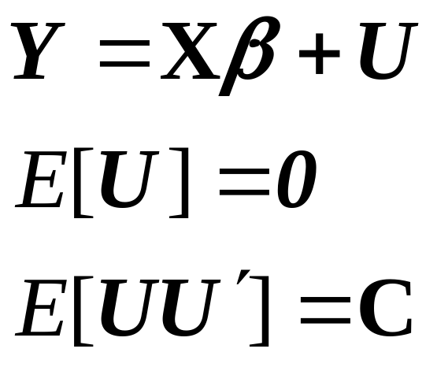
Spatial Regression Modeling
Objective:
  Testing for and estimating regression models that incorporate spatial effects
Recall GLS

Slide 44
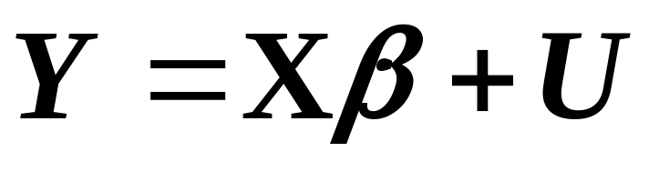
Spatial Regression Modeling
Generalized Least Squares
  2nd order effects?
  Questionable assumption of stationarity of 2nd order
  Distance measures?

Slide 45
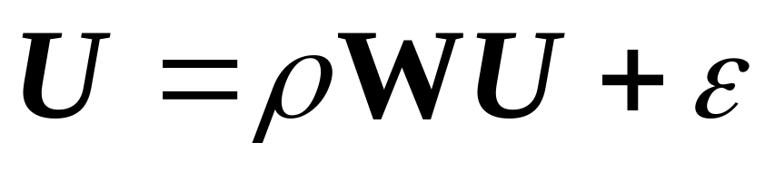
Spatial Regression Modeling
Autocorrelated errors model
Non-spatial part
Spatial part (residual pattern)

Slide 46
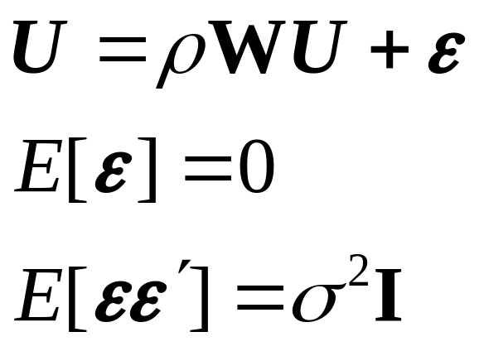
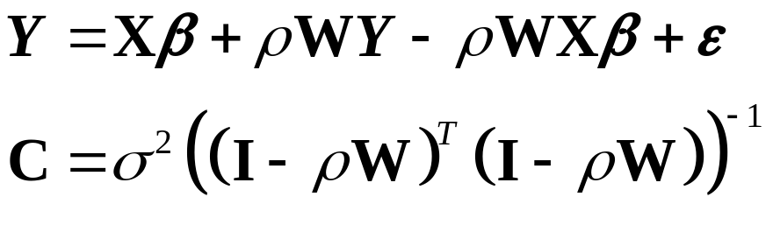
Autocorrelated Errors Modeling
  Rewriting:

Slide 47
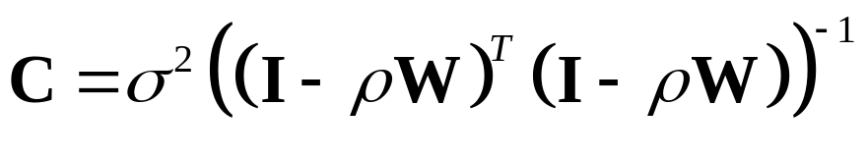
Estimation of the Spatial Model
OLS estimation not useful
Maximum likelihood estimation of β and ρ
Assumptions:
  y_{i} are observations on n random variables Y, jointly normally distributed with Mean = Xβ and Covariance matrix C, where

Slide 48
Estimation of a Spatial Model
Maximum likelihood estimation of β and ρ
What is the maximum likelihood function?

Slide 49
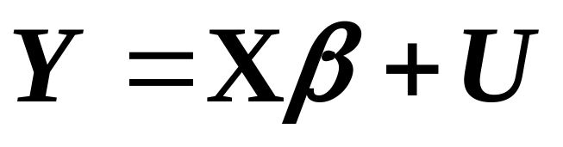
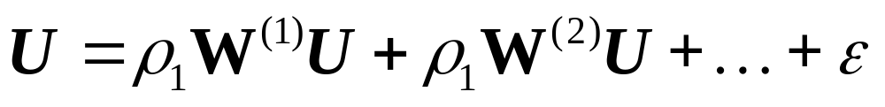
Alternative Spatial Models
Lag models

Slide 50
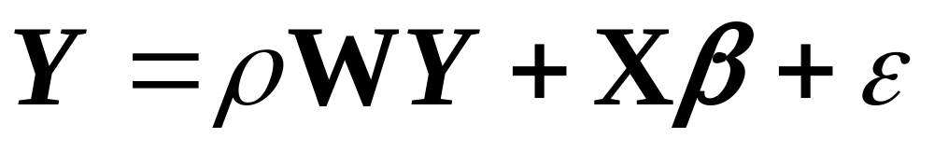
Alternative Spatial Models
Mixed regressive autoregressive
Spatial part
Non-spatial part

Slide 51
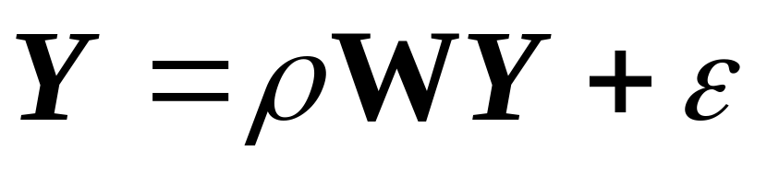
Alternative Spatial Models
Pure autoregressive
Spatial part

Slide 52
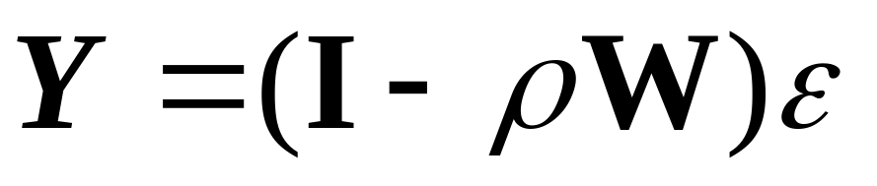
Alternative Spatial Models
Moving average model (map pattern)
Spatial part

Slide 53
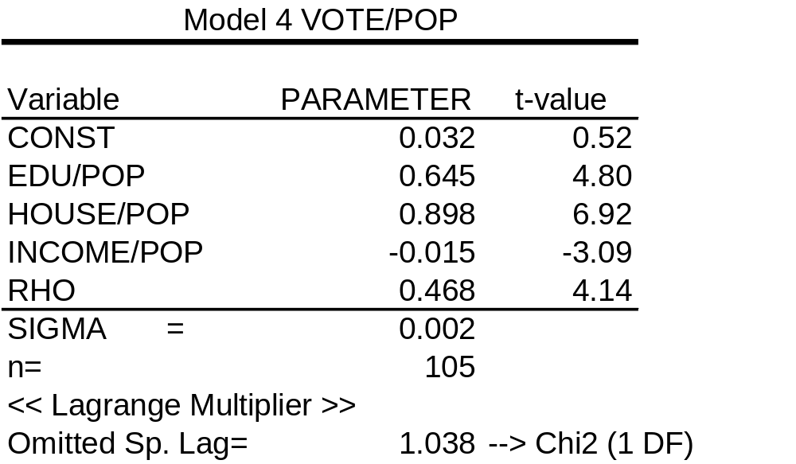
Spatial Regression
Fit autocorrelated errors model

Slide 54
Example
Model 2

Slide 55
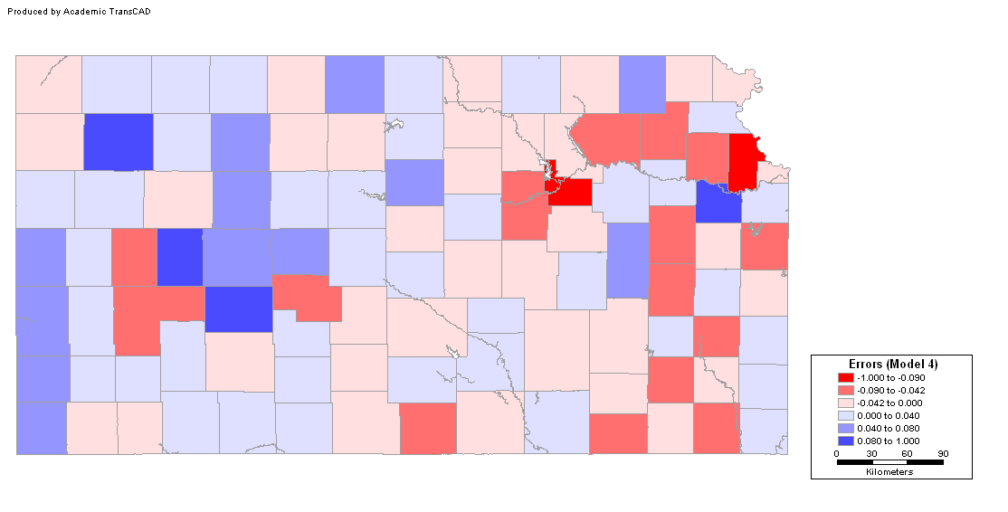
Analysis of Residuals
Are errors independent? Model 4

Slide 56
Analysis of Residuals
Are errors independent? Model 2

Slide 57
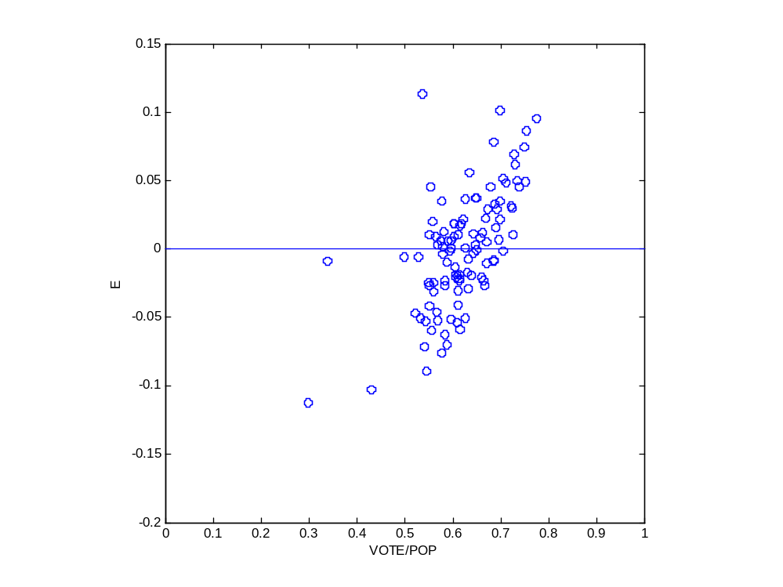
Analysis of Residuals
Is variance constant?
  Scatterplot of errors vs. variables

Slide 58
Analysis of Residuals
Are errors normally distributed?
  Histogram
  Probability plot
  Other tests (Jaques-Bera, Kolmogorov-Smirnov,Lilliefors)

Slide 59
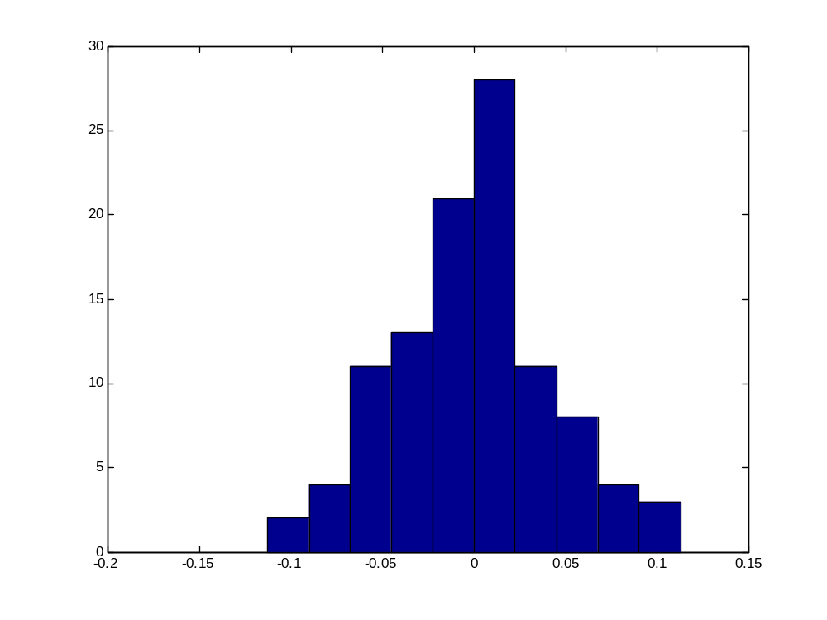
Analysis of Residuals
Histogram

Slide 60
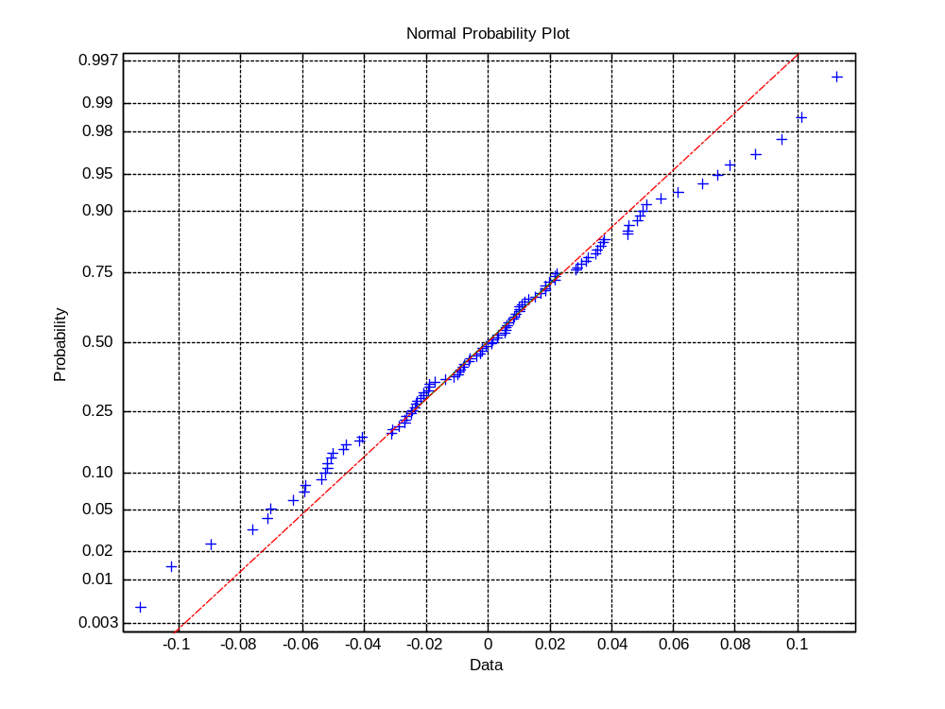
Analysis of Residuals
Probability plot

Slide 61
Analysis of Residuals
Other tests
  Test Normal?
  Jarque-Bera YES
  Kolmogorov-Smirnov YES
  Lilliefors YES .

Slide 62
Conclusion
The autocorrelated errors model is the best alternative
  Satisfies all major assumptions
  Accounts for all systematic spatial variation

Slide 63
Summary of modeling approach
Exploration
Models – non-spatial models, check assumptions
Models – spatial models, check assumptions and statistical fit
Think Theory!

